Slide 1
SENIOR
46-Párrafo Doble Tres externo adelante combinado con Rocker externo y Doble Tres atrás
39-Párrafo Bucle atrás
47-Párrafo Bracket externo adelante combinado con Counter interno y Bracket atrás
48-Párrafo Doble Tres externo atrás combinado con Rocker externo y Doble Tres adelante
38-Párrafo Bucle adelante
49-Párrafo Bracket externo atrás combinado con Counter interno y Bracket adelante
50-Párrafo Doble Tres externo adelante combinado con Counter externo y Doble Tres atrás
39-Párrafo Bucle atrás
51-Párrafo Bracket externo adelante combinado con Rocker interno y Bracket atrás
52-Párrafo Doble Tres externo atrás combinado con Counter externo y Doble Tres adelante
38-Párrafo Bucle adelante
53-Párrafo Bracket externo atrás combinado con Rocker interno y Bracket adelante
GRUPO 1
GRUPO 2
GRUPO 3
GRUPO 4

Slide 2
SENIOR
46-Forward outside Double Three combined with outside Rocker and backward Double Three paragraph
39-Back outside paragraph Loops
47-Forward outside Bracket combined with inside Counter and backward Bracket paragraph
48-Backward Double Three combined with outside Rocker and forward Double Three paragraph
38-Forward outside paragraph Loop
49-Backward outside Bracket combined with inside Counter and forward Bracket paragraph
50-Forward Double Three combined with outside Counter and backward Double Three paragraph
39-Back outside paragraph Loops
51-Forward outside Bracket combined with inside Rocker and backward Bracket paragraph
52-Backward outside Double Three combined with outside Counter and forward Double Three paragraph
38-Forward outside paragraph Loop
53-Backward outside Bracket combined with inside Rocker and forward Bracket paragraph
GROUP 1
GROUP 2
GROUP 3
GROUP 4

Slide 3
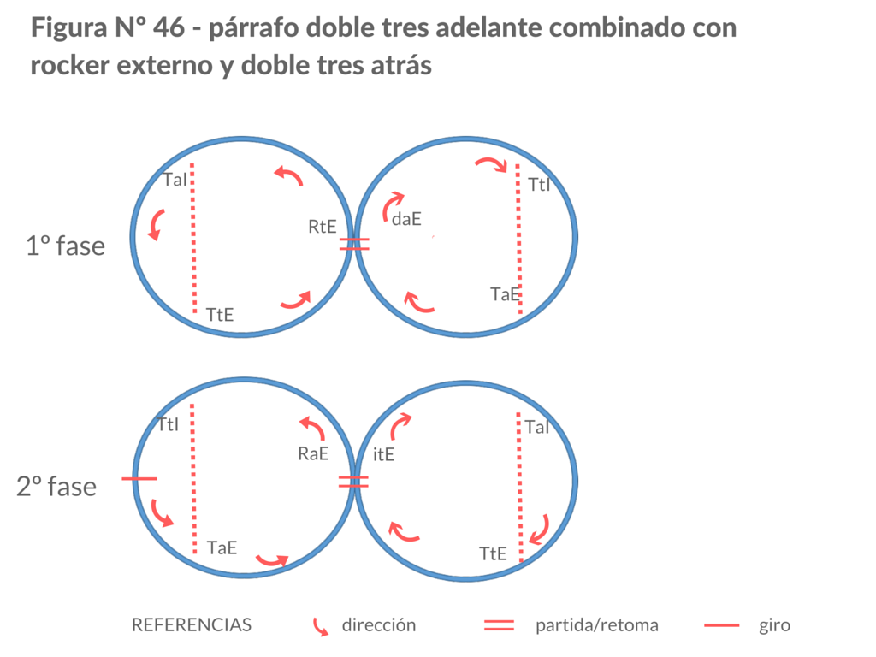

Slide 4
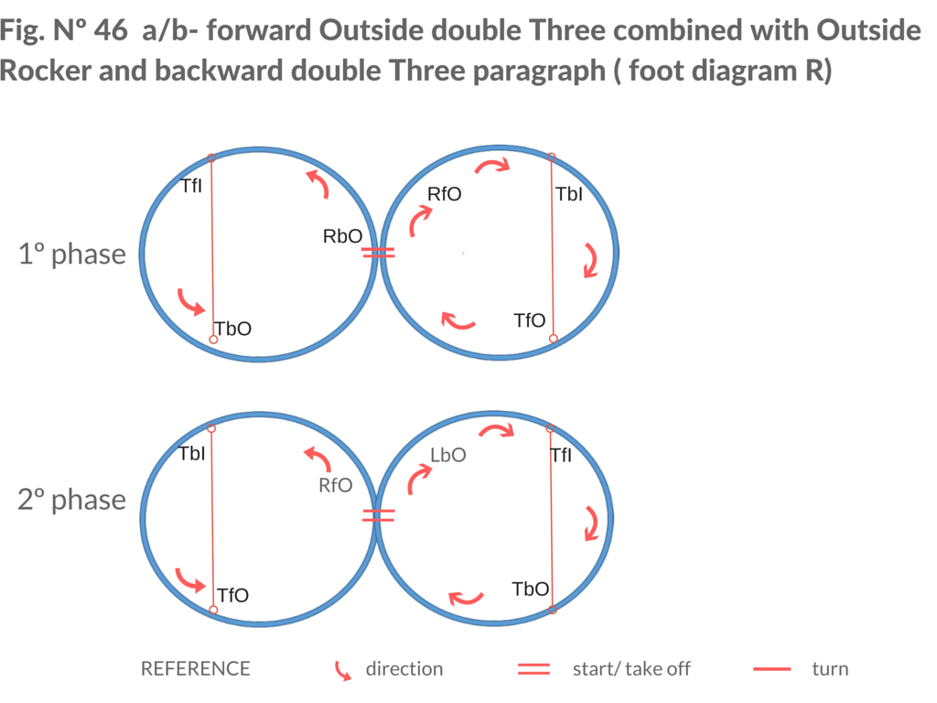

Slide 5
VIDEO

