Slide 1
World Skate anti-doping education
Nanjing - WORLD ROLLER GAMES

Slide 2
World Antidoping Agency (WADA)
World wide organisation under which all antidoping organisations operate (ADOs)
WADA sets policy to ensure all ADOs work under the same rules in all countries and sports world wide
Monitors compliance of all ADOs with world rules and standards

Slide 3
World Antidoping Agency (WADA)
World wide organisation under which all antidoping organisations operate (ADOs)
WADA sets policy to ensure all ADOs work under the same rules in all countries and sports world wide
Monitors compliance of all ADOs with world rules and standards

Slide 4
Antidoping Organisations (ADOs)
Responsible for implementing WADA policy
National Antidoping Organisations (NADOs)
  National level
International Federations (Ifs)
  International level
NADOs and International Federations work together and share information

Slide 5
SCOPE OF PRESENTATION
10 Possible Anti-doping Rule Violations
Prohibited List & Check your substances – working the process
Supplements & Strict Liability
Therapeutic Use Exemption (TUE)
Process of Testing and Results Management
Registered Testing Pool (RTP) and whereabouts
Risks and Consequences of Doping

Slide 6
Why do coaches, doctors and administrators have to participate in education. Support personnel are not tested.?
It is not necessary to be tested to have an anti-doping rule violations (ADRV) against you
The culture of the coach will strongly influence the decision of the athletes to dope or not.
Notes:
Download from FIRS webpage
Completed by athletes, coaches and support personnel
10 possible antidoping rule violations, only one depends on positive test
5 involve athletes and 5 athletes and/or support personnel
You don’t have to have a positive test to be sanctioned

Slide 7
Doping Programmes
Most successful doping programmes require assistance of medical personnel
There are 10 possible anti-doping rule violations (ADRV)
Only 1 depends on a positive test
5 apply to athletes
The other 5 apply to athletes and others

Slide 8
Anti-Doping Rule VIolations
ATHLETES ONLY
Presence of a prohibited substance, it’s metabolites or markers
Use or attempted use of a prohibited substance or method
ATHLETES & SUPPORT PERSONNEL
Tampering or attempting to tamper with the testing process
Refusing or evading a test
Trafficking or attempted trafficking of a prohibited substance
Administration or attempted administration of a prohibited substance
Possession of a prohibited substance
Whereabouts violation
Complicity
Prohibited association
Notes:
SPEAKING NOTES: Example Ferrari – Lance Armstrong, Fuentes blood doping – 200 packs of blood for transfusion. It is difficult to run an successful doping programme without skilled medical help
Don’t spend a great deal of time on this slide, and no need to speak on each point.
There are three main messages
You don’t have to test positive in order to be banned. In fact only the very first of the ten possible ADRVs involve testing positive. Thus even if you have never been tested yet, you still need to be aware of these rules
Even coaches and support personnel are subject to these rules. The Violations on the right are applicable to support people.

Slide 9
The Prohibited List
AT ALL TIMES
IN-COMPETITION
SUBSTANCES
METHODS
SUBSTANCES
Non-approved substances
Manipulation of blood and blood components
Stimulants
Anabolic agents
Chemical or physical manipulation
Cannabinoids
Peptide hormones, growth factors and related substances
Gene Doping
Narcotics
Beta-2 agonists
Glucocorticosteroids
Hormone and metabolic modulators
Diuretics and other masking agents
Notes:
Presenter information: There is a 6th one – diuretics and masking agents in column 1.Cannabinoids take a long time to clear the system. Positive result is an amount in xs of 150ng/ml increased from 15ng/ml. The increased level covers passive inhalation and is designed to catch people who are using in the competition period
When presenting this session – you can provide a brief overview of each of the categories of substances if you wish (and some tips are provided below), however it is not recommended to cover them in great detail as the information is unlikely to be retained by the audience.
It is more important on this slide to reinforce the concept that some substances are prohibited at all times – and others only during competition.
The most important thing for athletes, their coaches, families and medical advisors to understand is which substances and methods are prohibited. - ignorance is no excuse.
Background information:
The World Anti-Doping Code Prohibited List (the List) identifies classes of substances and methods that are not allowed in sport.
The List is set by WADA who are responsible for reviewing and updating the List on an annual basis. Any changes they make come into effect on January 1 every year.
The list is split up by substances and methods prohibited at all times, prohibited only in-competition, or prohibited only in particular sports – for example beta blockers and alcohol in motor sport.
DEFINITION:
In-Competition: generally refers to the period of time 12 hours before an event or competition begins through to the completion of the event and its associated doping control processes. Athletes should check their individual policies to ensure this is the same for their sport.
Substances that are prohibited at all times include:
Anabolic agents, commonly referred to as steroids
Hormones, growth factors and related substances, such as EPO and human growth hormone
Beta-2 agonists, the best known example is Symbicort
Hormone antagonists and modulators
Diuretics and masking agents
Methods that are prohibited include:
Enhancing the transfer of oxygen
Chemically or physically manipulating the sample
Gene doping
Substances that are prohibited in-competition include:
Stimulants
Narcotics
Cannabinoids (cannabis)

Slide 10
Medication with Permitted Level
Some medications have a permitted level
If a diuretic is in the system even with Therapeutic Use Exemption (TUE) the other substance must have a TUE as well
Examples are pseudoephedrine in cold and flu meds
Ephedrine
Salbutamol and other permitted asthma relievers

Slide 11
Substances of Interest
At all times
  Insulin
  Asthma Reliever Medication
  In Competition
  Cannabinoids
  Stimulants – dexamphatamine, methyphenidate, pseudoephidrine
  Corticosteroid by mouth, by rectum, IV or IM
  Narcotics – morphine like substances
  Other recreational drugs

Slide 12
Where to get Information – prohibited list, International Standards, Education
WADA website
www.wada-ama.org

Slide 13
How To Check your substances
Check with prohibited list –
Go to http://www.globaldro.com/
If you live in Canada, USA, Switzerland, Japan or Australia click on your country flag
Enter details of sport and preparation
Be sure to check all ingredients
Click other for other countries and you will be directed to your National Antidoping Organisation (NADO)
Notes:
Note name of all medications is under the trade name
Make sure you check them all - some trade names have different substances in different countries
eg sudafed PE and sudafed

Slide 14
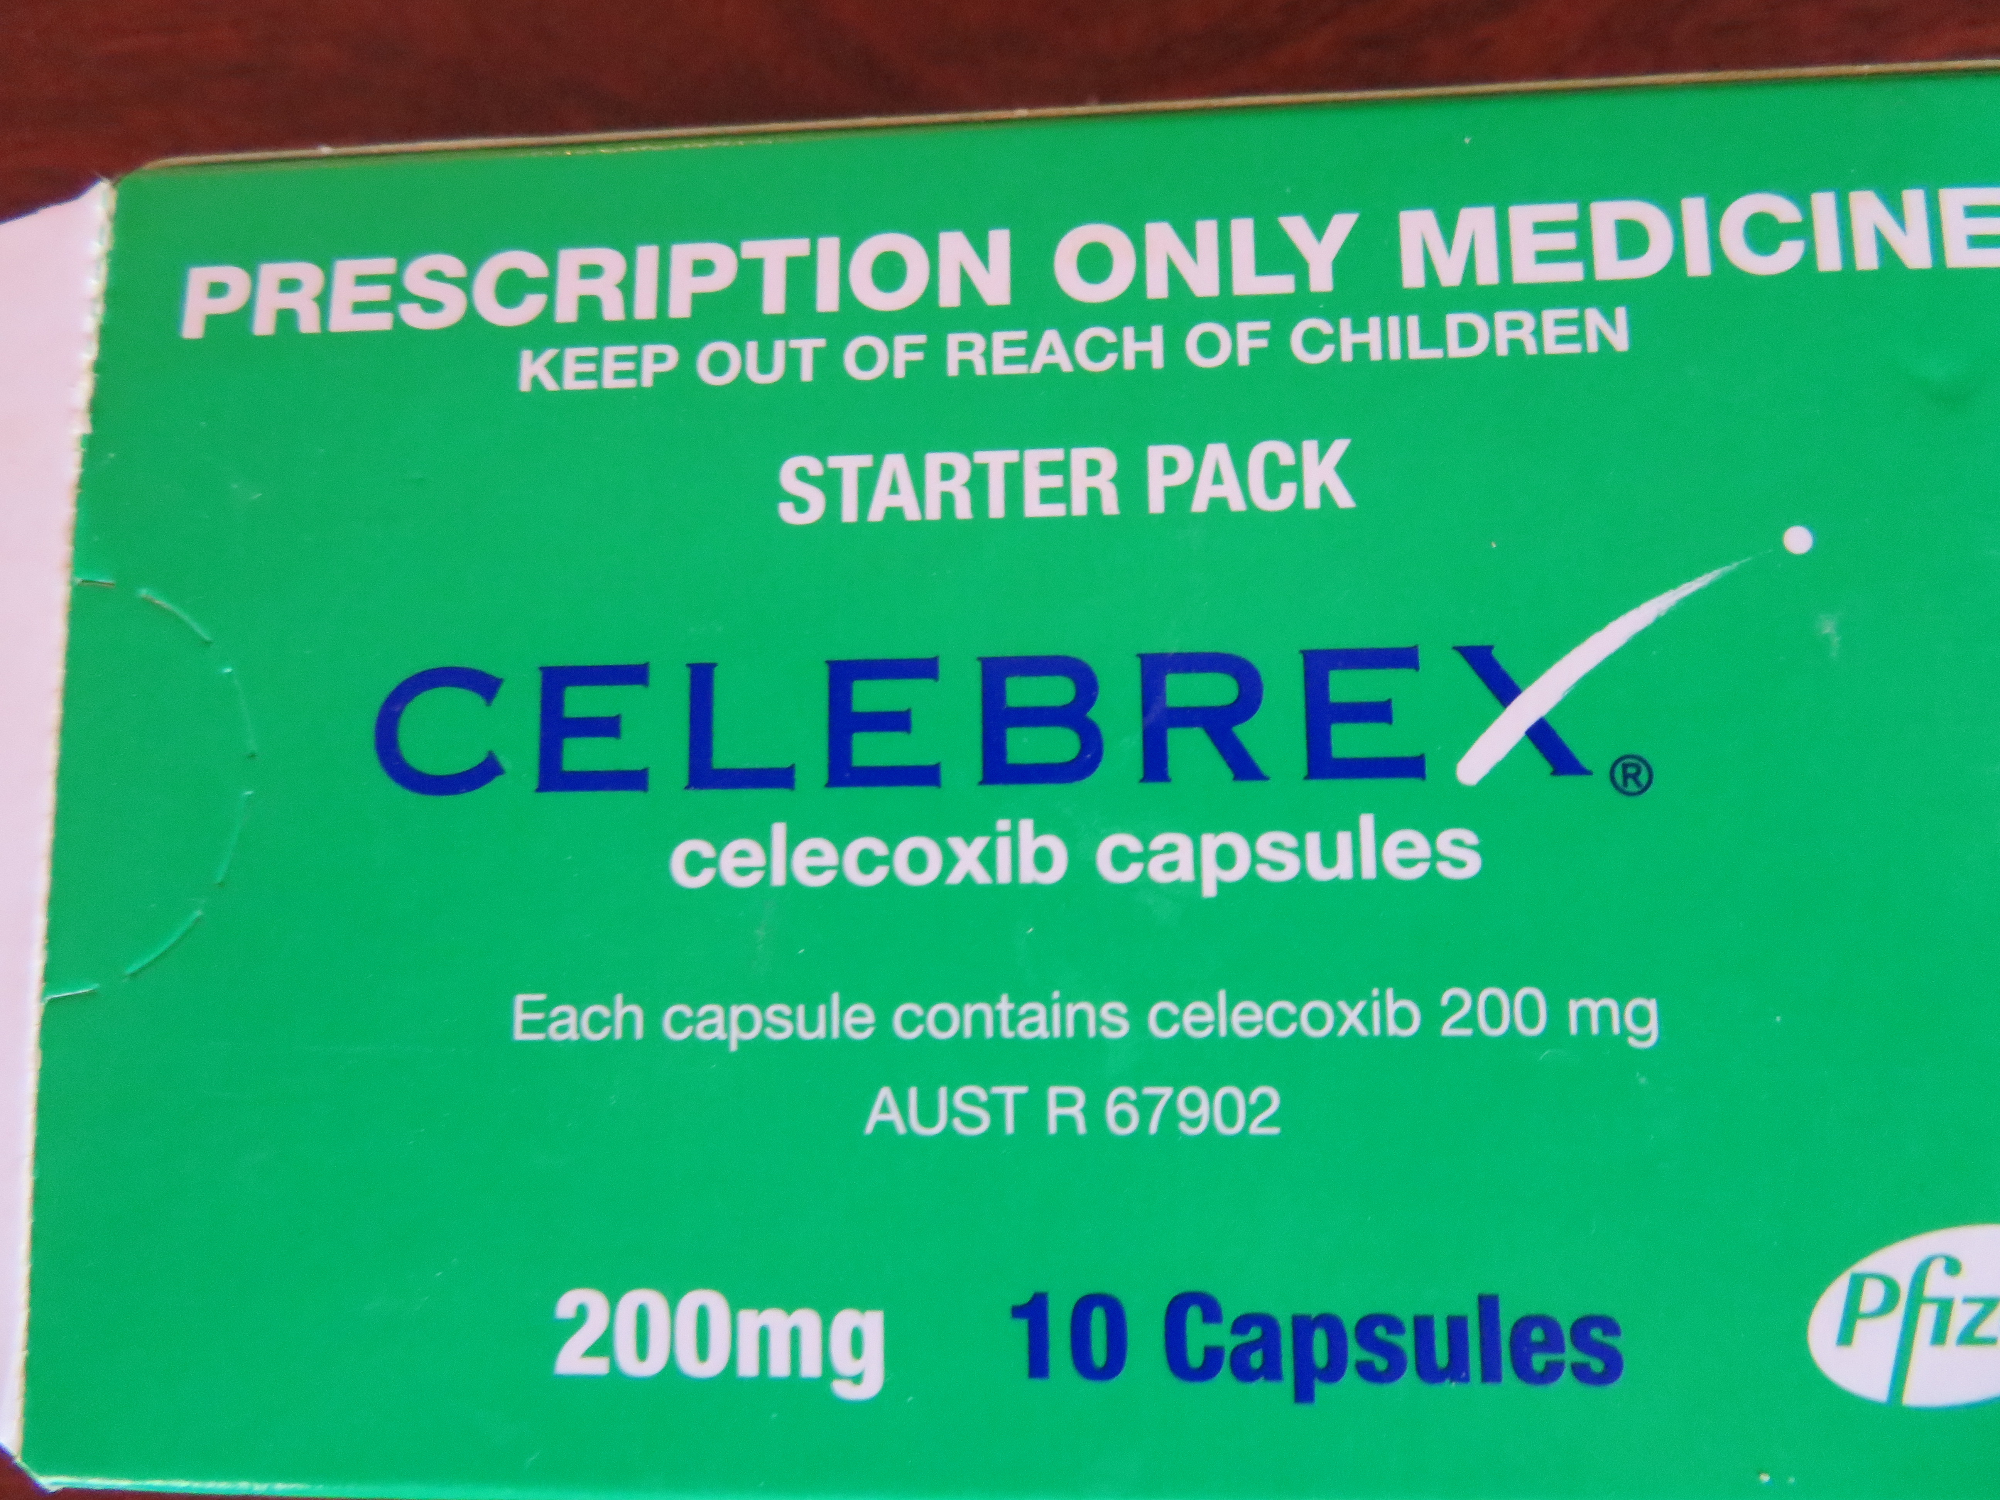
Reading medication packets

Slide 15
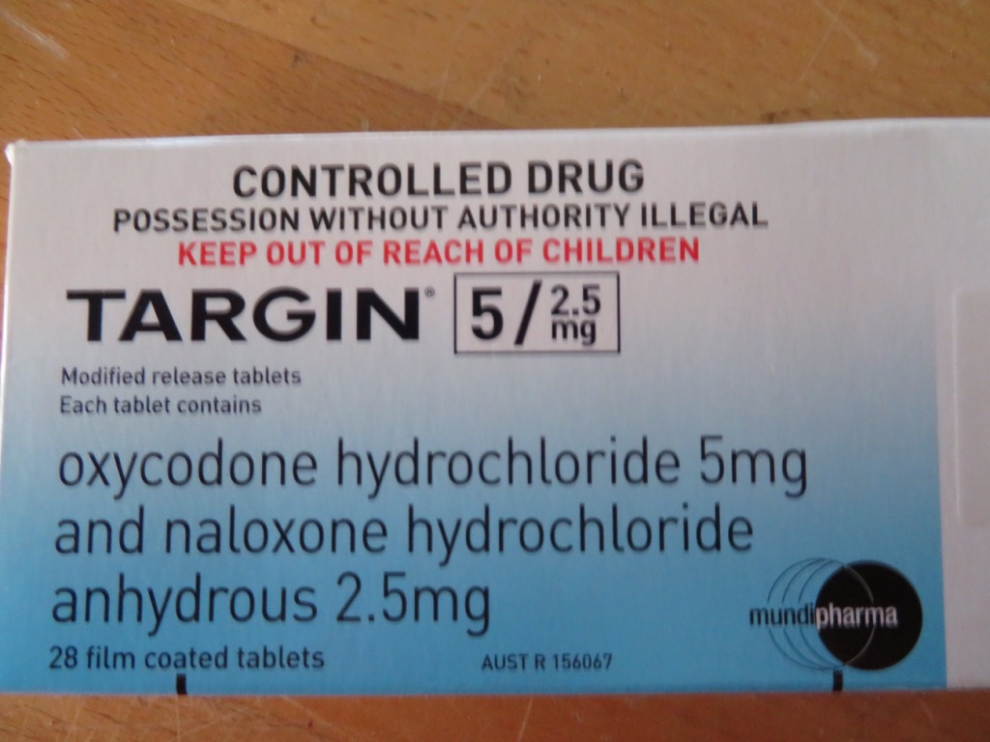
Medications with More than One Ingredient

Slide 16
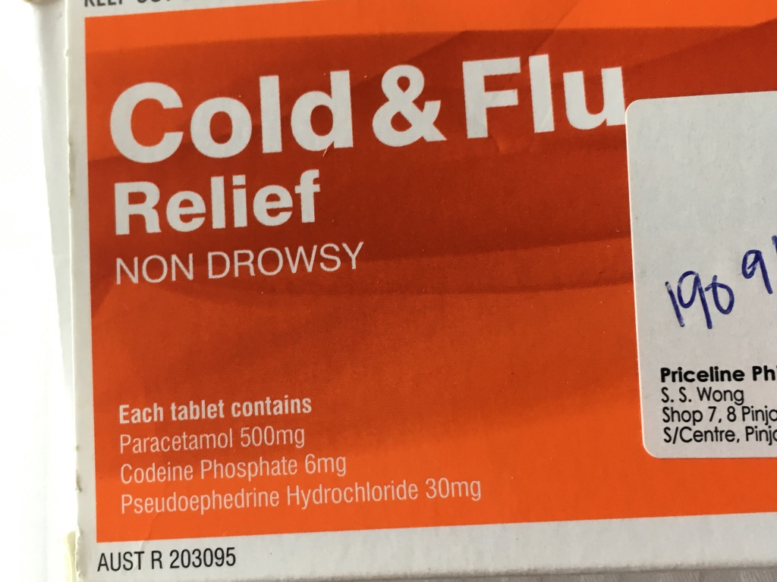

Slide 17
Asthma - a Word of Warning
There a three asthma relievers (beta agonist)that are permitted by WADA provided they are used to treat asthma in the dosage recommended by the manufacturer
  Salbutamol (ventolin, asmol)
  Salmeterol (seretide)
  Formoterol (foradile and symbicort)
Terbutaline (Bricanyl), which has been on the market for a long time as an asthma reliever, remains prohibited
Pharmaceutical companies have been heavily promoting other beta agonists to doctors including
  Indacaterol ( Onbrez with Breezhaler)
  Vilanterol (Breo with Ellipta device)
To reiterate, only the 3 beta agonists salbutamol, salmeterol and formoterol are permitted for doping control without TUE

Slide 18
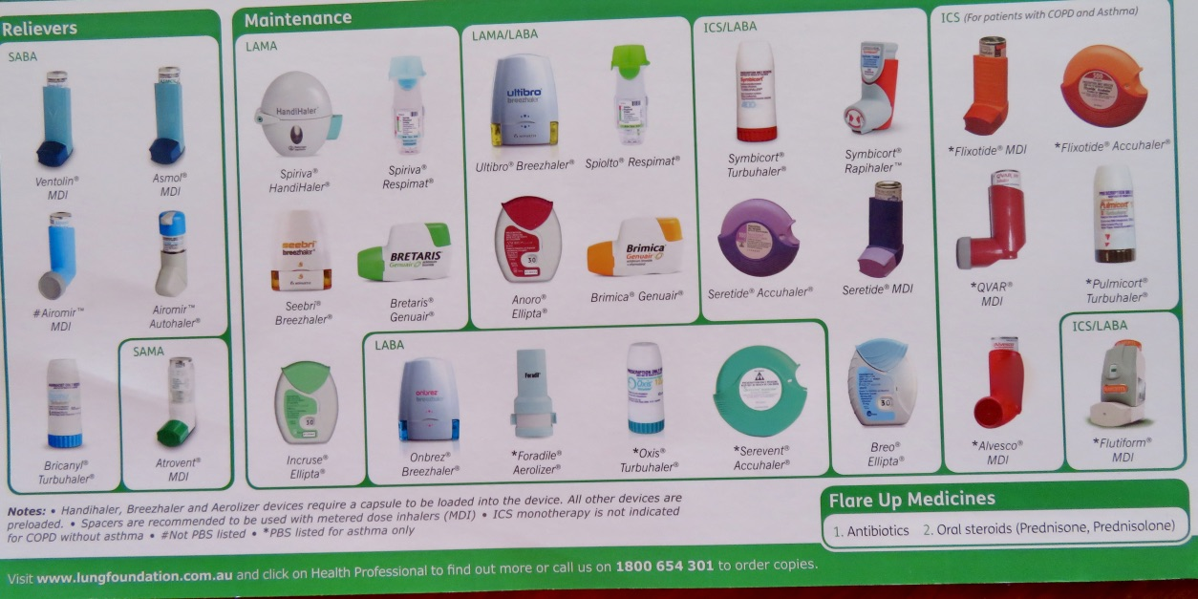
Asthma - a Word of Warning
Notes:
Asthma devices. Breo elipta is the blue device third from the right on the bottom

Slide 19
Supplements (1)
1 in 5 supplements on sale in Australia for athletes contained a banned substance. This is same situation world wide
Evidence is that supplements don’t work or they contain a known banned substance
There is a bigger danger from supplements purchased on the internet. A positive test can be due to deliberate false labelling by the manufacturer, contamination of the product in manufacturing or use of alternative name
Supplements can be injurious to athlete health eg Oxyelite – 1 died, 2 required liver transplant
Remember the athlete can be tested any time and takes total responsibility for a prohibited substance in his sample whether deliberate doping or not
Notes:
This slide gives some examples of why ASADA can’t provide a guarantee. Read through some of the cases linked below first to give you some background. The aim of the slide is to show that even simple supplement products could be a problem, and to emphasis the risks.
You can refer athletes to the free information available on the AIS website regarding supplements and which ones actually have any proved benefits anyway (very few).
Australian supplement survey http://www.supplementsinsport.com/
Vitamin B contaminations - http://www.webmd.com/vitamins-and-supplements/news/20130729/vitamin_b_supplement_contains_anabolic_steroids
Green Tea contamination - http://www.paralympic.org/press-release/brazilian-athlete-sanctioned-after-anti-doping-rule-violation
Liver failure, Diabetes and death from OxyElite Pro - http://www.medscape.com/viewarticle/812581 (one patient died, and two had liver transplants)
Third party testing: from companies like Informed-Sport and HASTA test individual batches of supplements against the prohibited list, and provide certification to manufacturers that their supplements are free of banned substances.
Supplements:
Assess the need
Before considering the use of supplements an athlete should look to optimise their diet, lifestyle and training. Consulting an accredited sports dietitian, nutritionist, or medical expert can help an athlete assess whether there is any need to, or benefit in, taking supplements.
Assess the risk
The risk of doping through the use of supplements is real. Prior to using any supplement, an athlete should ask themselves:
Is it legal?
Is it safe?
Is it effective (in improving performance)?
Is it necessary?
If in doubt about the first two questions, the product should not be used. The third and fourth questions are intended to help the athlete consider what potential benefit, if any, the supplement may offer.
Despite the claims made by supplement manufacturers that their products are safe and free of substances prohibited in sport, it is not possible to offer an absolute guarantee to athletes. It is for this reason ASADA and WADA do not endorse supplement products or offer advice to athletes about which supplement to take. There have been cases where both Australian and international athletes have been sanctioned after they have used supplements that they thought were safe, but were actually contaminated with prohibited substances.
If an athlete chooses to use supplements, they should weigh up the risks and make an informed decision.

Slide 20
Supplements (2)
High risk so why not consider alternatives
  Is the supplement really necessary
Would
  Improvement of diet help – consult dietician
  Adjust the training program
  If considered necessary then review Australian Institute of Sport web site www.ausport.gov.au/ais/nutrition/supplements/a-z_factsheets
  Consider third party testing www.informed-sport.com which tests individual batches of supplements for prohibited substances
  No ADO will guarantee supplements are safe for doping control because their production is largely unregulated
Notes:
Recent advice from ASADA re higenamine – 13 Australian athletes from 9 sports tested positive in last 12 months

Slide 21
Therapeutic Use Exemption (1) (TUE)
Some athletes suffer from illness that can only be treated with prohibited substances
Example a diabetic athlete requires insulin for survival
Therapeutic use exemption is a mechanism by which an athlete can get permission to use a prohibited substance to treat an illness
All athletes competing in World Skate World Championship, who are using prohibited substances to treat medical conditions, must have a TUE approved in advance by World Skate
A TUE issued by a NADO is acceptable provided it has been issued in accordance with international standards for TUE
Athletes competing in FIRS competitions, other than a World Championship, should have either a TUE approved by their NADO and/or prepare a medical file to apply for a retrospective TUE if tested

Slide 22
Therapeutic Exemption (2) TUE
How to Apply for a TUE
First check if the medication is prohibited www.globaldro.org
Check with the doctor if there is a permitted medication that could be used
If there is a permitted medication then athlete must provide evidence that this has be triallled and is not suitable
Download the application form from FIRS webpage www.rworldskate.org - sports medicine tab
Medical file must
  Have complete medical history including pathology and imaging provided by the treating doctor to support the diagnosis.
  Confirm that withholding medication would by injurious to athlete health and well being
  There is no treatment alternative that is not banned
  Athlete would not get an unfair advantage from taking the medication
Application must be at least 30 days in advance of the event is needed for consideration by TUE committee
A scribbled note from a doctor presented at the event is not acceptable for permission to use a prohibited substance

Slide 23

Doping Control Video
Notes:
https://www.youtube.com/watch?v=_p849msht_A
ASADA link

Slide 24
Process testing & results management
Notification
  An athlete selected for doping control is approached by a chaperone, notified of his selection, asked to sign the form and notified of his rights
  He must stay with chaperone at all times
  He must present to the doping control station immediately
  The DCO may give permission for the athlete to attend awards ceremonies, press conferences, other events etc but must be accompanied by the chaperone at all times
Athlete Rights
  The athlete is entitled to have one representative and an interpreter if needed
  The representative may not observe passage of the sample
  If the athlete is a minor there is an observer to watch the chaperone but not the passage of the sample

Slide 25
Process testing & results management
The Test
  When ready to provide a sample the athlete choses one of a number of sealed collection beakers
  He goes to the toilet area with the DCO or chaperone of the same gender
  He washes his hands and pulls his sleeves up to the elbows, top to upper chest level and bottoms to knees.
  The chaperone observes the sample leaving the body into the collection vessel
  The athlete returns to the sample office and the DCO
  The athlete selects a sample kit and checks all the numbers match
  The athlete opens the samples jar and pours at least 30 mls into the B sample and at least 60 mls into the A sample.
  The athlete seals the bottles, put into the transport package having again checked the numbers match
  No one except the athlete touches the sample and collection bottle
  The except to this is the DCO may help tighten the screws on the sample jars once they are closed

Slide 26
filling in the forms
The Forms
  Time of notification is recorded and signed by the athlete and the chaperone
  Time of arrival at the doping control station is recorded
  Athlete details are added to the form.
  Sample numbers, volume, specific gravity (sg) time of sealing the sample jars are recorded
  Always declare all preparation taken in the last 7 days including TUE meds, over the counter medications and supplements
  The laboratory receives sample numbers but not any indication of athlete identity
  Athlete and DCO check the completed forms & sign them
  Copies of the form is provided to the athlete and the anti-doping organisation.

Slide 27
Incomplete Samples
Partial Samples
  The minimum volume of urine required is 90 mls
  If less is provided then the amount is sealed as a partial sample
  When the athlete provides at least 90 mls the first sample is added to the 2nd sample in the collection beaker and mixed. The sample is then treated as usual

Slide 28
Dilute Sample
Dilute Samples
  The minimum specific gravity of a sample is 1.005
  An athlete providing a sample of less than this is asked to provide another sample
  In this situation athlete should avoid drinking too much fluid and also providing a second sample within an hour
  As many samples as necessary are collected until a sample of SG >1.005 is collected
  All samples are sent to the lab – usually only the first and the last are analysed in the first instance

Slide 29
results management
Positive Test
  The lab will notify the results management authority (usually World Skate)
  World Skate will check for valid TUE and that all processes have been followed
  World Skate will notify the athlete of anti-doping rule violated, consequences, provisionally suspend the athlete and offer B sample analysis
  The athlete may choose to waive B sample analysis, in which case the ADRV is considered to be proven
  Athlete and his representative may attend B sample analysis which is at the lab that analysed the A sample
  If the B sample analysis confirms A sample finding then an ADRV is proven
  The athlete is then offered a fair hearing to decide the sanction and is entitled to have legal representation at his own expense.
  All these steps have quite short time lines which the athlete must comply with

Slide 30
Registered testing pool (RTP) and whereabouts
Registered Testing Pool
  Is a group of elite athletes selected for no notice out of competition testing
  Athlete are notified when they are included on the registered testing pool and when they are removed
  To have an effective out of competition testing programme we need to know where the athletes are 24/7
  Athletes must file whereabouts to ADAMS
Whereabouts and filing failures
  RTP must file whereabouts for 3 months to ADAMS before the beginning of each quarter and update regularly when circumstances change
  RTP athletes must file overnight accommodation, training and competition schedules and whereabouts of regular activities
  They must provide a one hour testing slot between 5.00am and 11.00 pm when they can guarantee to be contacted for testing
  Athletes can be tested out with this testing slot

Slide 31
Whereabouts failures
  A filing failure applies
  if whereabouts are not filed on time
  If there is a missed test outside the 1 hour testing slot
A missed test applies if
  There is a missed test in the 1 hour testing slot
  A combination of 3 missed tests and/or filing failures in a 12 month period results in a sanction of between 12 and 24 months

Slide 32
Consequences of Doping
Banned from all sport and sporting activities – not just rollersports
Loss of reputation and credibility including with friends, family and other athletes
Loss of sponsorship, and income from sport eg coaching
Serious health consequences
Compromises “clean athletes”
Injurious to society, culture generally and sport
If we don’t have clean sport we don’t have anything
Notes:
Consequences doping leaflet

Slide 33
Conclusion
It is most important that we work together to support the clean athlete
I am always available to answer questions antidoping@worldskate.org
There will be an outreach program at the World Roller Games running as a joint venture between World Skate and CHINADA
I hope you take advantage of the learning programs to be more informed and to have some fun

Slide 34
Some Videos
Doping Control Process
https://www.youtube.com/watch?v=_p849msht_A
Some tips from athletes
https://www.youtube.com/watch?v=pkLugC1B9tw
Athletes talk about supplements
https://www.youtube.com/watch?v=hR4zHEmRfjY
These links take you to other videos that are well worth watching

Slide 35
Educational Resources
WADA – www.wada-ama.org
Click on what we do and then education
There are elearning resources such as ALPHA and programmes for support personnel in many languages
www.asada.gov.au
Click on elearning – lots of quality programmes in English
Your National Antidoping organisation (NADO) webpage
World Skate www.worldskate.org,
click on “about us” Sports Medicine and then education

