Slide 1

Prohibited List & Supplements
2021 Code

Slide 2

Prohibited List
2021/2022 lists are much more user friendly than previous lists
The document lay out is much easier to read
It has an index of topics at the front and substances at the back
Major sections are devided into subsections making it easier to follow

Slide 3
Language of the Prohibited List – “The List”
It is not possible to include all prohibited substances and methods on the list so language is used to cover this
The list talks about “including but not limited to” – means that similar substances in structure and function even if not specifically mentioned on the list are prohibited
…”and their metabolites and isomers”. Means breakdown products and products with reverse chemical structure are indictors of ingestion of a prohibited substance

Slide 4
Inclusion of Substances on the List
Any listed substance must meet at least 2 of the 3 criteria listed below
    It has the potential to enhance or enhances sport performance
    It represents an actual or potential health risk to the athletes
    It violates the spirit of sport
    Use of prohibited substances and methods is only one of the ways athletes can cheat. All cheating is unacceptable in our sport

Slide 5
The List
Some substances and methods are
  prohibited at all times
  prohibited only in competition
  prohibited in certain sports only
In competition is defined as from 23.59 on the day before the competition until all samples have been collected and the competition is cleared for doping control
Testing at any other time is “out of competition”

Slide 6
Non - Specified Substances
Non specified substances and methods are not generally used in the community
They are more likely to be used to enhance sporting performance rather than for any other reason
Positive test for a non specified substance attracts at least a 4 year sanction and requires an obligatory provisional suspension
There is little option to use clause 10 for reduction in sanction

Slide 7
Specified Substances
Specified substance are not to be considered less serious than non specified substances
They are more likely to be used in the general community for purposes not related to enhancement of sporting performance
Provisional suspension is optional for the athlete
If the athlete can prove use was not intentional to enhance sporting performance sanction can be reduced from 4 years to 2 years
Clause 10 – no or reduced negligence clause is more likely to apply
If the athlete continues to compete during the results management process and is subsequently sanctioned then all results and awards are disqualified for the date of the test

Slide 8
Substances of Abuse
This is a new category under the 2021 code
These are substances that are regularly abused in society outside the context of sport
Includes substances such as THC, cocaine, diamorphine (Heroine), MDMA / ecstasy
If the athlete can prove use was out of competition and not related to sport then a reduced sanction of blanket 3 months may apply
There is an option to reduce the sanction to one month if the athlete completes an approved “drug” education program

Slide 9
List Categories – Prohibited Substances
S0 – Non-approved substances
S1 Anabolic Steroids
S2 Peptide hormones, growth Factors, related substances and mimetics
S3 Beta Agonists
S4 Hormone and metabolic Modulators
S5 Diuretics and Masking Agents
S6 Stimulants A Non specified B specified
S7 Narcotics
S8 Cannabinoids
S9 Glucocorticoids

Slide 10
Prohibited at all Times – Prohibited Methods
M1 Manipulation of blood and blood products
M2 Chemical and physical manipulation
M3 Gene and cell doping

Slide 11
S0 – Non approved substances
These are substances that are not used to treat illness anywhere
They are not addressed anywhere else on the list
They include
  Drugs in development
  Drugs not intended for human use
  Designer drugs Medication used to circumvent the list itself

Slide 12
S1 – Anabolic Steroids
These agents are prohibited at all times
They are used
  To increase power and acceleration
  To enhance any power training program
  To speed recovery from injury

Slide 13
Example of Anabolic Steroids
Testosterone
Stanozolol
Selective androgen receptor modulators (SARMS)
Tetrahydrogestrinone
Many anabolic substances some found in supplements and compounded products
SARMS are commonly found in nutritional supplements

Slide 14
S2 – Peptide Hormones, Growth Factors, Related Substances
S1.1 Erythropoetins and agents affecting production of red blood cells
e.g. EPO – given by injection so not easy to use unwittingly
Hypoxia- inducible factor (HIF) Substances that induce low oxygen levels in the blood to encourage the body to make more red blood cells (cells that carry oxygen) .g. Cobolt

Slide 15
S2.2 Peptide Hormones, Growth Factors
S2.2 Peptide hormones and releasing factors
Chorionic gonadotrophin and releasing factors– a substance produced in pregnancy
Therefore not appropriate in males
  Can occur in some pathological states e.g. testicular cancers
  Examples are buserelin and gonadorelin
Growth hormone (GH) and its fragments and releasing factors

Slide 16
S2.3 Growth Factors and Growth Factor Modulators
All are prohibited at all times
Fibroblast growth factor (FGFs)
Insulin like growth factor (IGF-1)
Platelet derived growth factor (PDGF)
PRP is permitted
Peptides are administered by injection so not easy or credible to use accidentally
Be very careful about any “vitamin preparations” given by injection

Slide 17
S3 – beta-agonists – asthma relievers
All beta-agonist are prohibited, including the levo isomers of salbutamol (levosalbutamol) and formoterol (arformoterol)
The levo isomers of salbutamol and formoterol are not available in all countries
Be very careful to check the form of salbutamol and formoterol you have been prescribed as it is easy to make a mistake
Salbutamol greater than 1000ng/ml and formoterol greater than 40ng/ml are not considered to be therapeutic for the management of asthma

Slide 18
Permitted beta agonists for the treatment of asthma by inhalation + conditions
The following beta agonists are permitted by inhalation for the management of asthma under following conditions
Inhaled salbutamol (Ventolin or asmol)– Maximum 1600 mcg/in 24 hours – not more than 600mg in any 8 hour period from starting dose
Inhaled formoterol (in Symbicort) Max delivered dose 54mcg over 24 hours
Inhaled salmeterol (in Seretide) 200 mcg in 24 hours
Inhaled vilanterol (Breo elipta) 25 mcg over 24 hours Vilanterol has been added to the list in 2021

Slide 19
Permitted beta agonists
Salbutamol greater than 1000ng/ml and formoterol greater than 40ng/ml are not considered to be therapeutic for the management of asthma
Level in excess of above without TUE will be considered as an Adverse Analytical Finding (AAF) unless the athlete proves by a controlled pharmacokinetic study that the abnormal result was the consequence of a therapeutic dose of up to the maximum dose indicated above given by inhalation

Slide 20
S4 Hormone and Metabolic Modulators
S4.1 & S4.2 are specified Substances
  S4.1Aromatase inhibitors
  S4.2 Anti-oestrogen substances and selective oestrogen receptor modulators (SERMS)
S4.3 & S4.4 are non-specified substances
  S4.3 Agents preventing activin receptor activation
  S4.4 Metabolic Modulators Activators of AMP kinase, Insulin, meldonium Trimetazidine

Slide 21
S5 Diuretics and Masking Agents
Prohibited at all times
all specified substances
Includes desmopressin probenecid, plasma expanders eg invtravenous administration on albumin, dextran, hydroxethyl starch and mannitol
Acetazolamide, frusemide, spironolactone, chlorothiazide and hydrochlorothiazide

Slide 22
Diuretic + Substance with a Permitted Threshold
Carefull
If the athlete has a TUE to use a diuretic the he needs an additional TUE to use any substance that has a threshold i.e. permitted under a certain level
Detection of threshold level substances in the presence of a masking agent without a TUE will attract an AAF even if within the limits
Be aware that some women use diuretics to prevent fluid retention in second half of the cycle – not permitted without a TUE

Slide 23
Prohibited Methods
M1 Manipulation of Blood and Blood Components
All prohibited methods are non-specified except M2.2 IV infusions
Administration of any form of blood products even your own blood into the circulators system
Artificially enhancing the uptake, transport or the delivery of oxygen but using modified haemoglobin products or any other means excluding inhaled oxygen
Any form of intravascular manipulation of blood by any physical or chemical means

Slide 24
M2 Chemical and Physical Manipulation
Tampering, and altering the integrity of samples collected at Doping Control
M2.1 Includes sample or athlete substitution, adulteration of the sample e.g. adding proteases
M2.2 Specified
IV infusions more than a total of 100mls in 12 hours except received in the course of hospital treatments surgical procedure or clinical diagnostic investigations

Slide 25
M3 Gene & Cell Doping
Prohibited at all times
The use of nucleic acids and analogies to alter genetic sequencing or to alter gene expression by any mechanism
The use of normal or genetically modified cells

Slide 26
S6 Stimulants
Stimulants are prohibited in competition
They are in both non-specified and specified categories
Any stimulant not listed in the non specified category is specified

Slide 27
S6A Stimulants Non-Specified
There is a big list so we will concentrate on common ones
Cocaine – can come under substances of abuse if the athlete can prove out of competition use not related to sport
Lisdexamfetamine – use in the management of ADHD and requires a TUE
Modafil – used by shift workers to help keep awake
Phentermine – component of diet pills eg duramine

Slide 28
S6.2 Specified Stimulants
Ephedrine, methylephedrine pseudoephridrine are prohibited over their threshold limit
Pseudoephidrine should stop 24 hours before in competition period starts
They are components of commonly uses cold and flu preparation so be careful check ingredients
Octopamine and others – component in supplements so be careful – check the product

Slide 29
S7 Narcotics
Specified Substance – Substances of Abuse
Prohibited in competition
Morphine or Opiate related substances
Use as pain killing medication, as drugs of abuse and also in management of addiction
Examples are buprenorphine, methadone, pentazocine, fentanyl, morphine

Slide 30
S8 Cannabinoids
Prohibited in competition
All natural and synthetic cannabinoids are prohibited
In cannabis (hashish, marijuana and cannabis products
Natural and synthetic tetrahydrocannabinoids (THC)
Synthetic cannabinoids that mimic THC
Cannabidiol is permitted

Slide 31
S9 Glucocorticoids
Glucocorticoids applied to the skin, as a nasal spray or inserted into the eye are permitted in and out of competition
Results management will always check if detected amount is compatible with any stated method of administration

Slide 32
S9 Glucocorticoids
Glucocorticoid are prohibited in competition if administered by mouth, rectum or injection including into and around a joint from 1 January 2022
Glucocorticoids used by inhalation for the treatment of asthma are permitted in competition
All glucocorticoids are permitted out of competition
Remember to allow washout time for glucocorticoid to leave the system before competition
If you test positive after use of glucocorticoid out of competition you may apply for retroactive TUE. You need diagnosis and medical file as for any other TUE application

Slide 33
Recording on The Doping Control Form
Always remember to record ALL medication you have used in the last 7 days
Include medication and substances you have bought in the pharmacy, at the supermarket, the naturopath and have on prescription
Suggest you have a list of exactly the preparation you are using and the dosage

Slide 34
How to Check Your Substance
Globaldro
Go to https://www.globaldro.com/Home
Select the country
Put in exact name of medication
Put in Australia and then we will check Sudafed
If the trade name is not recognized put in the name of ALL the component medications

Slide 35
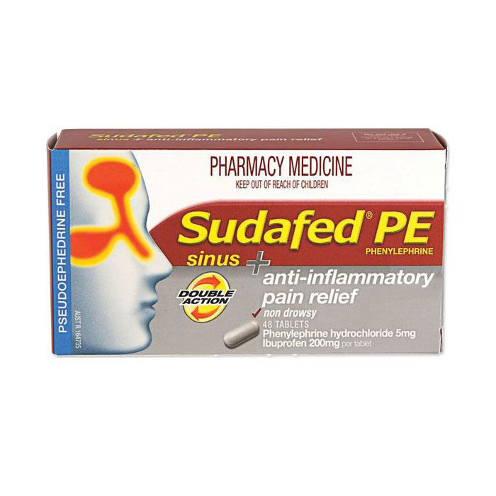

Slide 36
